Slide 1
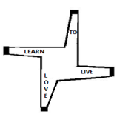
St Brigid’s School
Mullingar
Bob Keating
Principal
January 29th 2015

Slide 2
Objectives for this presentation
Tonight....
Look at St Brigids
&
Look at Special Education provision

Slide 3
Terminology
The first thing about Special Education is the terminology. Professionals love terminology.
There is loads of it ... all with the underlying goal of clarifying how we understand children who need extra support in school.
Here is a sample...

Slide 4
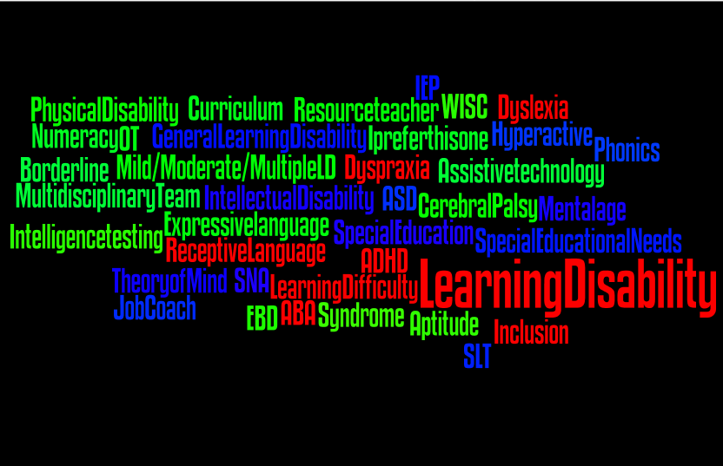
Terminology can be varied and difficult

Slide 5
Underpinning all Terminology
Always Remember to put the child first… say She’s a girl with Down Syndrome not a Down Syndrome girl

Slide 6
Children with LDs have challenges with
Attention
Perception
Short term memory
Comprehension
Expression
Coping with change
Notes:
Perception and pain threshold sometimes higher
Perception and food/diet some children react adversely to coke

Slide 7
A child with LDs
Lifelong condition
Differing degrees of severity
Borderline
Mild
Moderate
Severe
Profound
Notes:
We teach children to cope with their LD we give them coping skills

Slide 8
In the last 20 years there has been a Change in thinking
Away from the medical to the social model
Away from Your disability stops you ...
To The curriculum needs to change as it stops you
Notes:
Often Change you have a DS child to a child with DS

Slide 9
How is ability measured?
Intelligence Quotient (IQ) is a number assigned by psychologists to how we think and learn. Using that number this Schools can apply for support.
By measuring how much a student knows (their IQ) Psychologists can recommend levels of support eg – Number of resource teaching hours, SNA support, extra equipment, or school placement

Slide 10
IQ & The Bell curve

Slide 11
IQ Alternative thinking
An alternative and broader definition is suggested by Howard Gardiner
Multiple Intelligences
Not just IQ –
rather where
Everyone is smart in some way
Not just IQ But how we think and Learn
Notes:
We work on bringing all of these other areas academics are not the most nb thing. We use this model to promote

Slide 12
Gardiner’s 8 Multiple Intelligences
Logical – Mathematical
Spatial
Linguistic
Musical
Bodily Kinaesthetic -Sporty
Interpersonal – Interaction with others
Intra Personal – Self
Naturalistic – Hunter Gatherers
Existential - Spiritual

Slide 13
The Gap
Children’s learning is represented by the diagonal
The curved line represents the learning of Children who need extra support
‘The gap’ is the distance which gets wider and becomes more apparent as the students get older
All students continue to learn but their rate of progress is different

Slide 14
What is different in St Brigid’s?
St Brigid’s is a different school which specifically caters for students with Learning Difficulties
St Brigid’s has smaller classes, timetabling is shorter, intensity of interaction and learning higher
We focus on Predictability, Structure, Pitch and Pace

Slide 15
What is different in St Brigid’s?
If a child is not learning we will ask
How can our teaching change to suit the child’s needs?
We believe
If children don't learn the way you teach you have to teach the way they learn

Slide 16
Who recommends St Brigid’s?
Parents always decide
Parents
Teachers
Student Need
SENO
Professionals

Slide 17
St Brigid’s School
Our Job is to teach the children in our care. This also involves teaching our students to cope with their LD
We often aim to give them these coping skills
there is a focus on Functional Skills, academics with a progression to certification

Slide 18
St Brigid’s is a Special School here we aim to provide a learning environment, in which each student is happy, secure, motivated, sensitively challenged, appreciated & fulfilled. We are committed to promoting a child-centred approach to education where a child’s worth is validated but not measured by academic attainments alone.
Enrolment policy 2015

Slide 19
Our role as educators
To promote the independence of your child
To develop his/her skills & abilities
To advocate for students
To raise a community profile
To be a role model
To support every learner to achieve their potential.

Slide 20
St Brigid’s
Centrally located in Mullingar for 30 years
Provides a service to students whose primary descriptor is a Mild or Moderate LD
9 classes 3 primary 6 second level
Students can access Primary curriculum, Junior Cert & FETAC programmes
Uniform is worn
Transport is provided by DES
Lunch is provided in School

Slide 21
St Brigid’s School
80+ students attend St Brigid’s
20+ students in primary
3 classes, 3 class teachers, 6 assistants
35+ Students follow a Junior Cert course
4 classes, 4 class teachers, 4.5 assistants
25+ students follow a FETAC programme called NCVA
2 classes, 2 class teachers, 4 assistants
Home Economics; Woodwork; IT and Art Teachers/Tutor from the VEC
Irish Dance, Self Defence and Horse riding
SLT, Physio, OT From the HSE

Slide 22
Here are 10 +
reasons to consider
St Brigid’s School

Slide 23
Creating Independent Learners
SMALLER
CLASS SIZE
6-11 Students

Slide 24
Creating Independent Learners
2. LIFE SKILLS

Slide 25
Creating Independent Learners
3. LITERACY NUMERACY
& IT

Slide 26
Creating Independent Learners
4.
PRIMARY CURRICULUM

Slide 27
Creating Independent Learners
5.
QQI FETAC PROGRAMMES*
*As each students’ age, needs and abilities dictate.

Slide 28
Creating Independent Learners
6. Elements of LEAVING CERTIFICATE*
*As each students’ age, needs and abilities dictate.

Slide 29
Creating Independent Learners
7. JUNIOR CYCLE STUDENT AWARDS*
*As each students’ age, needs and abilities dictate.

Slide 30
Creating Independent Learners
8.
DIFFERENTIATED INDIVIDUAL PROGRAMMES + IEPs

Slide 31
Creating Independent Learners
9.
CLASS-BASED SNA SUPPORT
SNA
CARE NEEDS
SENSORY ORIENTATION
INDEPENDENCE & Social Skills Training
Health & Safety

Slide 32
Creating Independent Learners
10.
GAISCE
WORK EXPERIENCE DEVELOPING SKILLS FOR INCLUSION

Slide 33
Application Process - When
Usual enrolment time is September
Places are offered after March and as long as places are available until September
Most Advantageous entry age
Primary school as recommended
Secondary school when leaving primary school (age 12)

Slide 34
Application Process
Come and visit the school we are having an OPEN DAY for students next Thursday February 5th
We need a psychological report (no more than 2 years old) with a recommendation for placement in a school for students with Mild/Moderate LDs

Slide 35
Application Process
Complete an Expression of Interest form (available this evening)
Achievement & Attendance Report from the previous school
Any other relevant Reports
Visit the school again if required
Complete Transport and NCSE forms
Usual enrolment time is September
Places are offered after March and as long as places are available until September

Slide 36
What Parents say...
St Brigid’s School has brought out the best in my child – he is pushed to the limits of what he thinks are his capacities and beyond
“The first thing that strikes you when you visit the class is the wonderful atmosphere in the room, the pupils are always calm and relaxed and happy.
We have noticed a huge difference in our child since coming to St Brigid’s. She is allowed to work at her own pace and learns lots of life skills. We also feel that the school is very supportive.

Slide 37
What staff say
I have noticed that students in St Brigid’s are happy in themselves & content
Students attend every day they wouldn’t come
in if they didn’t want to

Slide 38
What the Inspectors say
Our Inspection report states ‘the caring and supportive staff provides an environment which is highly responsive to students learning needs’ additionally ‘such a positive approach contributes greatly to the learning environment and the social and personal needs of students’ where ‘students’ individual achievements and successes are celebrated’.

Slide 39
What students say
“There is a lot of to learn and it is fun to do”
“ I can’t believe I did this .... I am so proud of myself’
.
“Staff will not give out they will try to solve the problem and sort it out”

Slide 40
Remember
St Brigid’s is different - as a school it may suit your child
If you Apply for a place in St Brigid’s you can always defer and remain on our ‘Expression of Interest’ List.

Slide 41
St Brigid’s is a Special School here we aim to provide a learning environment, in which each student is happy, secure, motivated, sensitively challenged, appreciated & fulfilled. We are committed to promoting a child-centred approach to education where a child’s worth is validated but not measured by academic attainments alone.

Slide 42
Finally
Thank you for attending our Open Evening. Thank you to all the staff who prepared for this evening and gave of their time and efforts above and beyond, showing by their actions they all want the best for the students of St Brigid’s
Please take a flyer and an Expression of Interest Form on the way out. Our website is now open and a copy of this presentation is available there www.stbsschool.wix.com/stbs

Slide 43
Questions
Lá Feile Bhríd Shona Daoibh

